Slide 1



Slide 2

Welcome to Lake County Local Deals
Key concepts to cover
Main teaching points
Important topics
Discussion points
Notes:
Key concepts to cover: Discuss the main concepts and theories that students need to understand for this topic.
Main teaching points: Highlight the most important learning objectives and key takeaways from this section.
Important topics: Cover the essential topics that form the foundation of understanding for this subject area.
Discussion points: Encourage student participation by asking questions and facilitating group discussions about the material.

Slide 3

Understanding Lake County Local Deals
Key concepts to cover
Main teaching points
Important topics
Discussion points
Notes:
Key concepts to cover: Discuss the main concepts and theories that students need to understand for this topic.
Main teaching points: Highlight the most important learning objectives and key takeaways from this section.
Important topics: Cover the essential topics that form the foundation of understanding for this subject area.
Discussion points: Encourage student participation by asking questions and facilitating group discussions about the material.

Slide 4

A Dedicated Local Deal Marketplace
Key concepts to cover
Main teaching points
Important topics
Discussion points
Notes:
Key concepts to cover: Discuss the main concepts and theories that students need to understand for this topic.
Main teaching points: Highlight the most important learning objectives and key takeaways from this section.
Important topics: Cover the essential topics that form the foundation of understanding for this subject area.
Discussion points: Encourage student participation by asking questions and facilitating group discussions about the material.

Slide 5

Supporting Small Businesses, Not Just a Platform
Key concepts to cover
Main teaching points
Important topics
Discussion points
Notes:
Key concepts to cover: Discuss the main concepts and theories that students need to understand for this topic.
Main teaching points: Highlight the most important learning objectives and key takeaways from this section.
Important topics: Cover the essential topics that form the foundation of understanding for this subject area.
Discussion points: Encourage student participation by asking questions and facilitating group discussions about the material.

Slide 6

Subscription Model: How it Works
Key concepts to cover
Main teaching points
Important topics
Discussion points
Notes:
Key concepts to cover: Discuss the main concepts and theories that students need to understand for this topic.
Main teaching points: Highlight the most important learning objectives and key takeaways from this section.
Important topics: Cover the essential topics that form the foundation of understanding for this subject area.
Discussion points: Encourage student participation by asking questions and facilitating group discussions about the material.

Slide 7

Key Benefit: Keep 100% of Revenue
Key concepts to cover
Main teaching points
Important topics
Discussion points
Notes:
Key concepts to cover: Discuss the main concepts and theories that students need to understand for this topic.
Main teaching points: Highlight the most important learning objectives and key takeaways from this section.
Important topics: Cover the essential topics that form the foundation of understanding for this subject area.
Discussion points: Encourage student participation by asking questions and facilitating group discussions about the material.

Slide 8

No Commission, Just Subscription
Key concepts to cover
Main teaching points
Important topics
Discussion points
Notes:
Key concepts to cover: Discuss the main concepts and theories that students need to understand for this topic.
Main teaching points: Highlight the most important learning objectives and key takeaways from this section.
Important topics: Cover the essential topics that form the foundation of understanding for this subject area.
Discussion points: Encourage student participation by asking questions and facilitating group discussions about the material.

Slide 9

Community Focus: Lake County Only
Key concepts to cover
Main teaching points
Important topics
Discussion points
Notes:
Key concepts to cover: Discuss the main concepts and theories that students need to understand for this topic.
Main teaching points: Highlight the most important learning objectives and key takeaways from this section.
Important topics: Cover the essential topics that form the foundation of understanding for this subject area.
Discussion points: Encourage student participation by asking questions and facilitating group discussions about the material.

Slide 10

Serving Lake County's Diverse Cities
Key concepts to cover
Main teaching points
Important topics
Discussion points
Notes:
Key concepts to cover: Discuss the main concepts and theories that students need to understand for this topic.
Main teaching points: Highlight the most important learning objectives and key takeaways from this section.
Important topics: Cover the essential topics that form the foundation of understanding for this subject area.
Discussion points: Encourage student participation by asking questions and facilitating group discussions about the material.

Slide 11

Spotlight: Clermont, Leesburg, Eustis
Key concepts to cover
Main teaching points
Important topics
Discussion points
Notes:
Key concepts to cover: Discuss the main concepts and theories that students need to understand for this topic.
Main teaching points: Highlight the most important learning objectives and key takeaways from this section.
Important topics: Cover the essential topics that form the foundation of understanding for this subject area.
Discussion points: Encourage student participation by asking questions and facilitating group discussions about the material.

Slide 12

Spotlight: Mount Dora, The Villages
Key concepts to cover
Main teaching points
Important topics
Discussion points
Notes:
Key concepts to cover: Discuss the main concepts and theories that students need to understand for this topic.
Main teaching points: Highlight the most important learning objectives and key takeaways from this section.
Important topics: Cover the essential topics that form the foundation of understanding for this subject area.
Discussion points: Encourage student participation by asking questions and facilitating group discussions about the material.

Slide 13
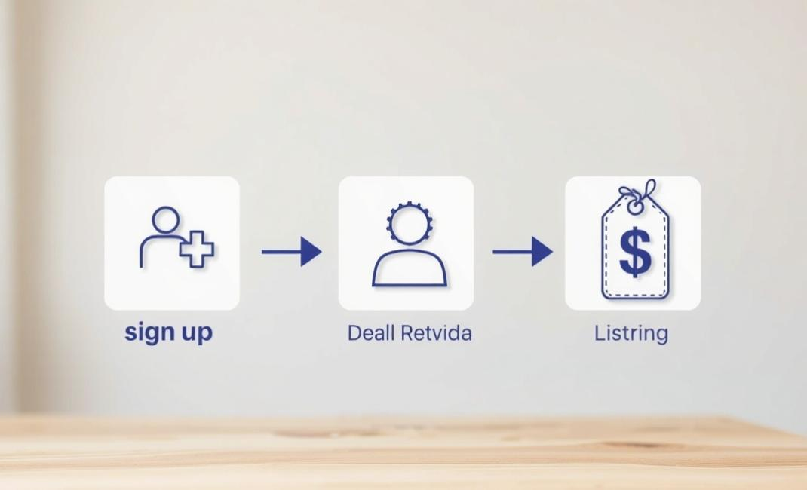
Getting Started: Your Next Steps
Key concepts to cover
Main teaching points
Important topics
Discussion points
Notes:
Key concepts to cover: Discuss the main concepts and theories that students need to understand for this topic.
Main teaching points: Highlight the most important learning objectives and key takeaways from this section.
Important topics: Cover the essential topics that form the foundation of understanding for this subject area.
Discussion points: Encourage student participation by asking questions and facilitating group discussions about the material.

